Slide 1
PHASE 18 • KEY-DRIVER PRIORITIZATION
From run-level KDA evidence to a focused key-driver atlas
Selection logic • cross-network recurrence • evidence breadth • descriptive sex/APOE patterns
MT drivers and non-MT drivers are ranked separately within seven broad cell-network models.
Prepared from validated Phase 18 outputs • 16 August 2026

Slide 2
PRESENTATION ROADMAP
02
Agenda
Three sections move from candidate selection to independent genetic support and then to network and proteomics validation.
Key-driver selection & evidence landscape
Slides 03–11
01
Selection logic, MT/non-MT recurrence, evidence breadth, synthesis, and descriptive sex/APOE patterns.
Human genetic support
Slides 12–15
02
Public summary data, direct-mapping rules, context-aware grading, and the candidate-level result profile.
Key-driver networks & proteomics validation
Slides 16–35
03
Place APOE, RPL11, COX7C, SELENOW, and LAMTOR5 on cell-type network graphs, examine protein-level coherence, and define proteomics validation.
Narrative arc: prioritize candidates → seek independent human evidence → place key drivers on networks and validate at the protein level.

Slide 3
03
SECTION 01
01
Key-driver selection & evidence landscape
How 25 candidates emerged across 47 displayed network contexts—and where support recurs.
IN THIS SECTION
Selection logic
MT / non-MT evidence
Sex / APOE patterns

Slide 4
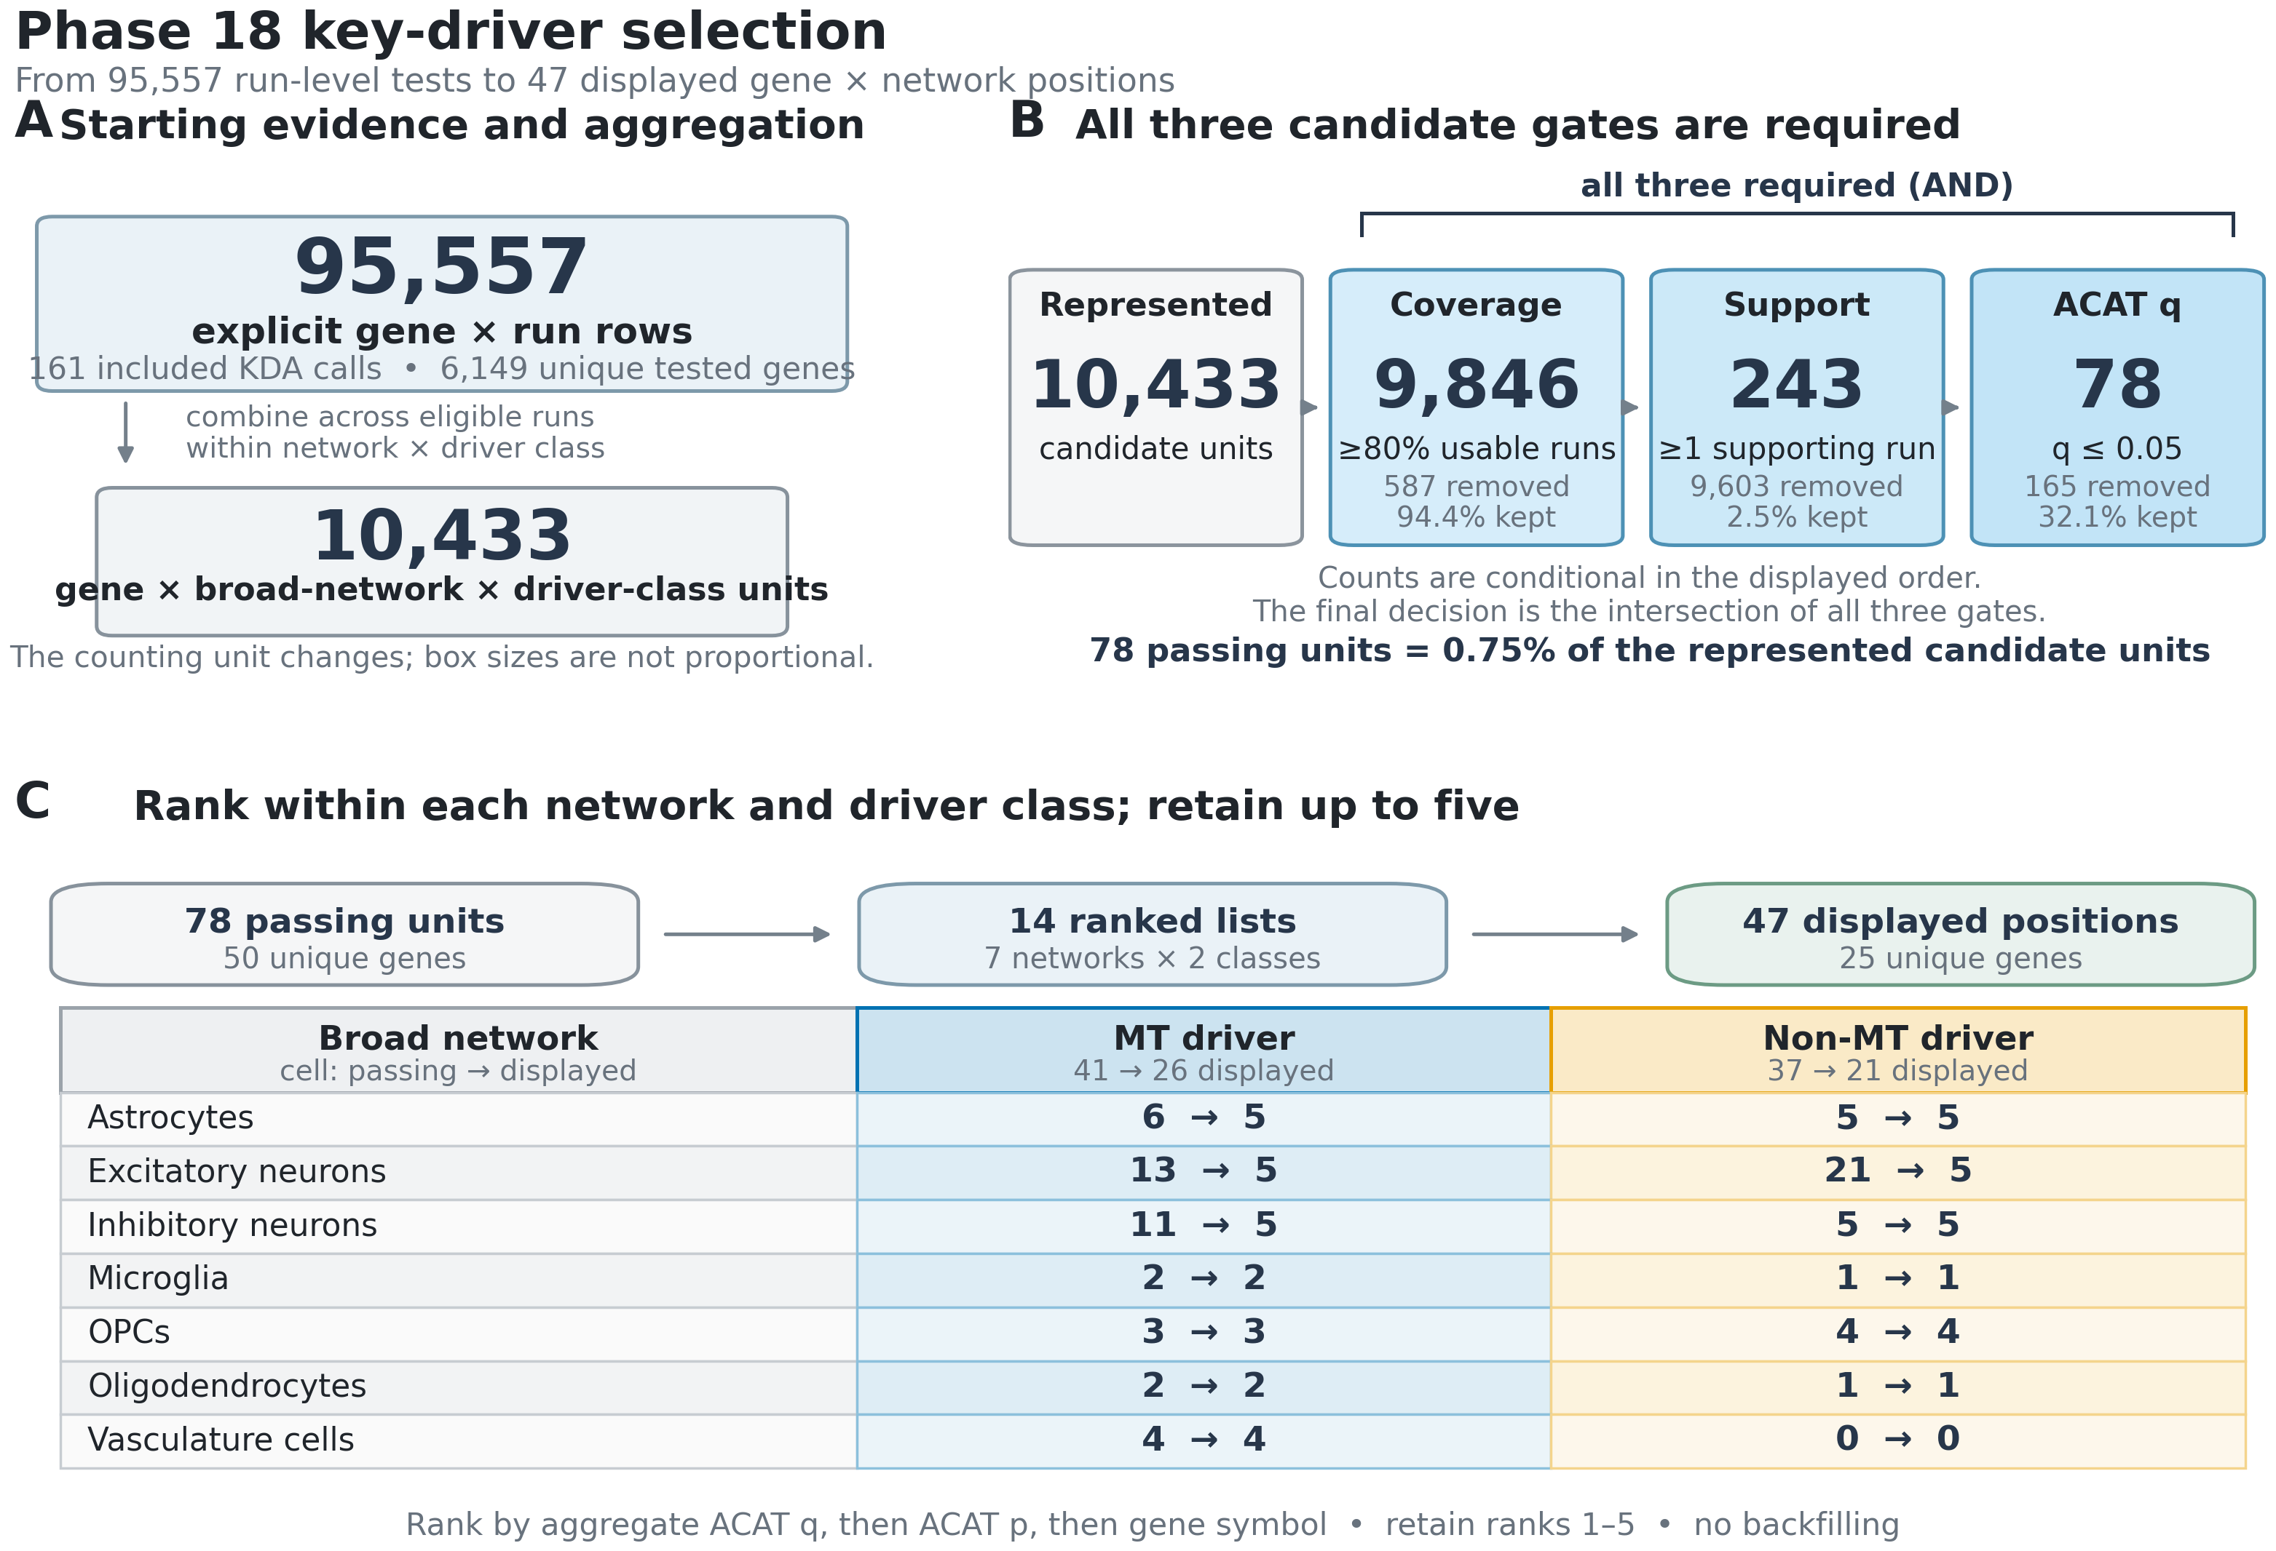
SELECTION PROCESS
04
A strict intersection of coverage, support, and aggregate evidence
The pipeline changes counting units as run-level tests are aggregated into network × driver-class candidates.
What earns a place
All three gates are required: ≥80% usable-run coverage, ≥1 conservative-support run, and aggregate ACAT q ≤ 0.05.
The intersection retains 78 of 10,433 represented candidate units (0.75%).
Candidates are ranked independently in 14 lists: 7 broad networks × 2 driver classes.
Ranks 1–5 are displayed with no backfilling when fewer candidates pass.
47
25
displayed gene × network positions
unique displayed genes
Prioritization—not proof of causal regulation.
Source: phase18_key_driver_selection_process.png and accompanying validated caption/methods

Slide 5
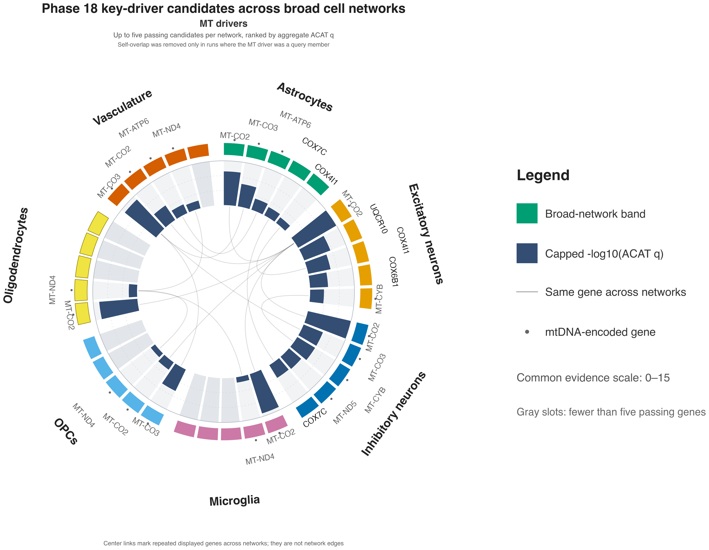
MT view: 10 genes occupy 26 displayed positions; MT-CO2 recurs in 7 of 7 networks, while gray slots preserve lists with fewer than five passers.
Source: phase18_mt_driver_circular.png • center curves show recurrence, not network edges

Slide 6
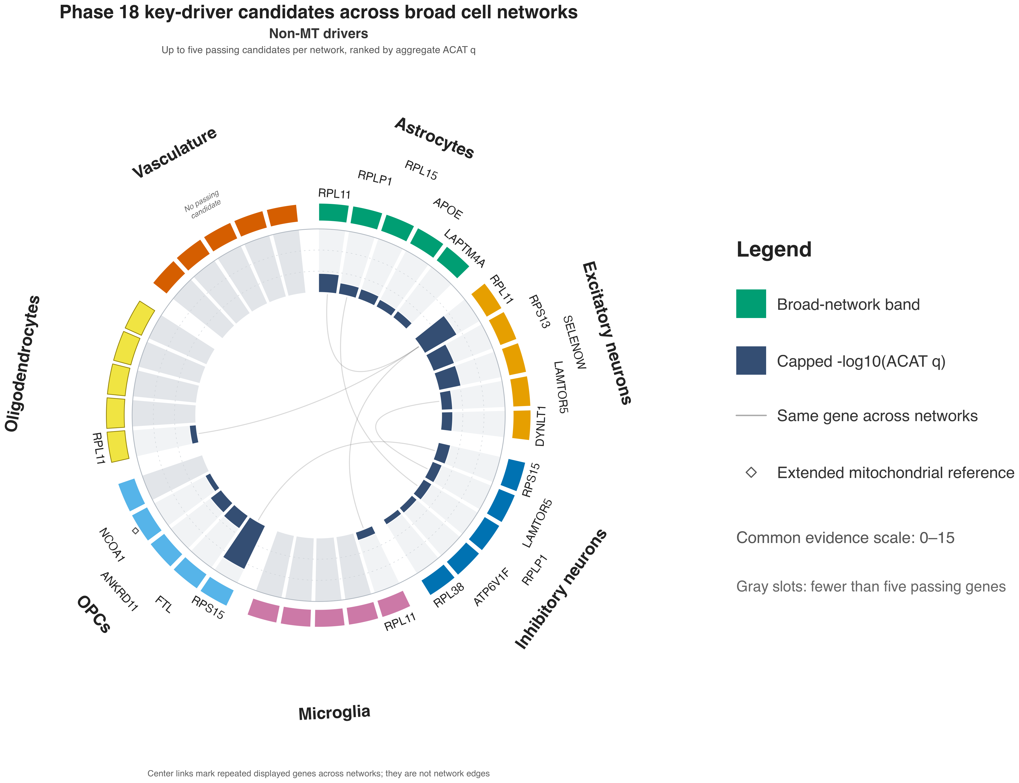
Non-MT view: 15 genes occupy 21 displayed positions; RPL11 recurs in 4 networks, and vasculature has no passing non-MT candidate.
Source: phase18_non_mt_driver_circular.png • non-MT means outside core MitoCarta, not absence of mitochondrial function

Slide 7
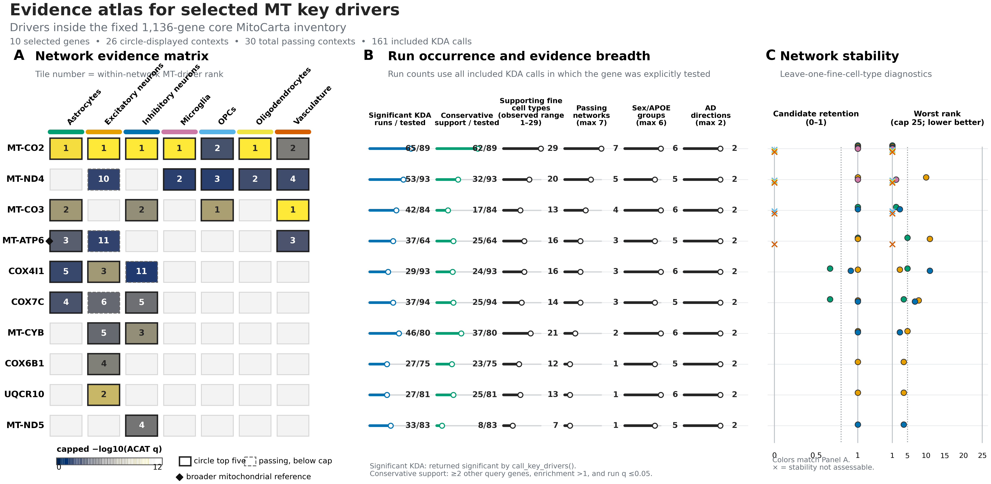
MT evidence is broadest for MT-CO2: 62/89 conservative-support runs, 29 fine cell types, all 7 networks, all 6 primary groups, and both AD directions.
Source: phase18_evidence_atlas_mt.png • stability is diagnostic and did not determine selection

Slide 8
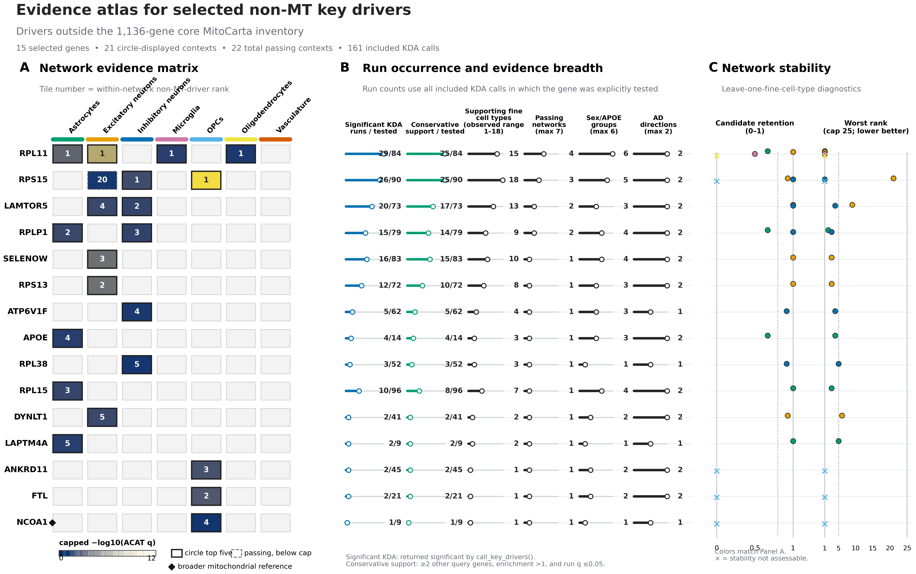
EVIDENCE ATLAS • NON-MT
08
Ribosomal candidates carry the broadest non-MT evidence
Network evidence, recurrence, breadth, and leave-one-fine-cell-type stability are complementary summaries.
Presentation readout
RPL11 passes in 4 networks with 25/84 conservative-support runs across 15 fine cell types.
RPS15 has the widest non-MT fine-cell breadth (18) and passes in 3 networks.
The dashed RPS15 excitatory-neuron tile passed selection but ranked below that network's five-gene display cap.
RPL/RPS genes recur across networks; LAMTOR5 spans excitatory and inhibitory networks; APOE is astrocyte-localized.
The top-five rule is a display cap—not an evidence threshold.
Source: phase18_evidence_atlas_non_mt.png and gene summary TSV

Slide 9
SYNTHESIS
09
What Phase 18 establishes—and what it leaves open
The broad atlas establishes which candidates emerged; the next slides localize support before the candidate case studies.
Selection
MT landscape
Non-MT landscape
78 passing units become 47 displayed network positions across two separately ranked driver classes.
Respiratory-chain genes dominate recurrence; MT-CO2 is the clearest cross-network sentinel.
Ribosomal candidates lead breadth and recurrence, with additional signaling, trafficking, and APOE-linked hypotheses.
Interpretive boundary: the figures prioritize network-associated key-driver candidates and show where evidence recurs. They do not prove causality or formally test sex/APOE interactions.
Next: localize candidate evidence across sex/APOE strata, then examine APOE, RPL11, COX7C, SELENOW, and LAMTOR5 in depth.
Slides 13–15 add independent human-genetic support; slide 17 introduces the validation panel; slides 18–35 show APOE, RPL11, COX7C, SELENOW, and LAMTOR5 network/protein examples

Slide 10
SEX/APOE EVIDENCE • MT
10
MT support is widespread but uneven across descriptive strata
Each row is a gene × broad-network context; columns partition AD-up and AD-down queries by sex and APOE group.
How to read the matrix
Dot area = fraction of usable queries with conservative support; fill = capped −log10(stratum ACAT P).
Small open circles mean usable tests with zero conservative support; dashes mean no eligible query.
The right tracks report official network-level q, support/usable, coverage, evidence tier, and rank.
Descriptive pattern
AD-up female ε3/ε3: 68 supporting runs across 15 contexts
AD-down male ε2: 65 supporting runs across 30 contexts
AD-up female ε2: 63 supporting runs across 15 contexts
These are not formal sex, APOE, or interaction tests.
Source: phase18_sex_apoe_mt.png • supporting-run totals are descriptive across displayed contexts

Slide 11
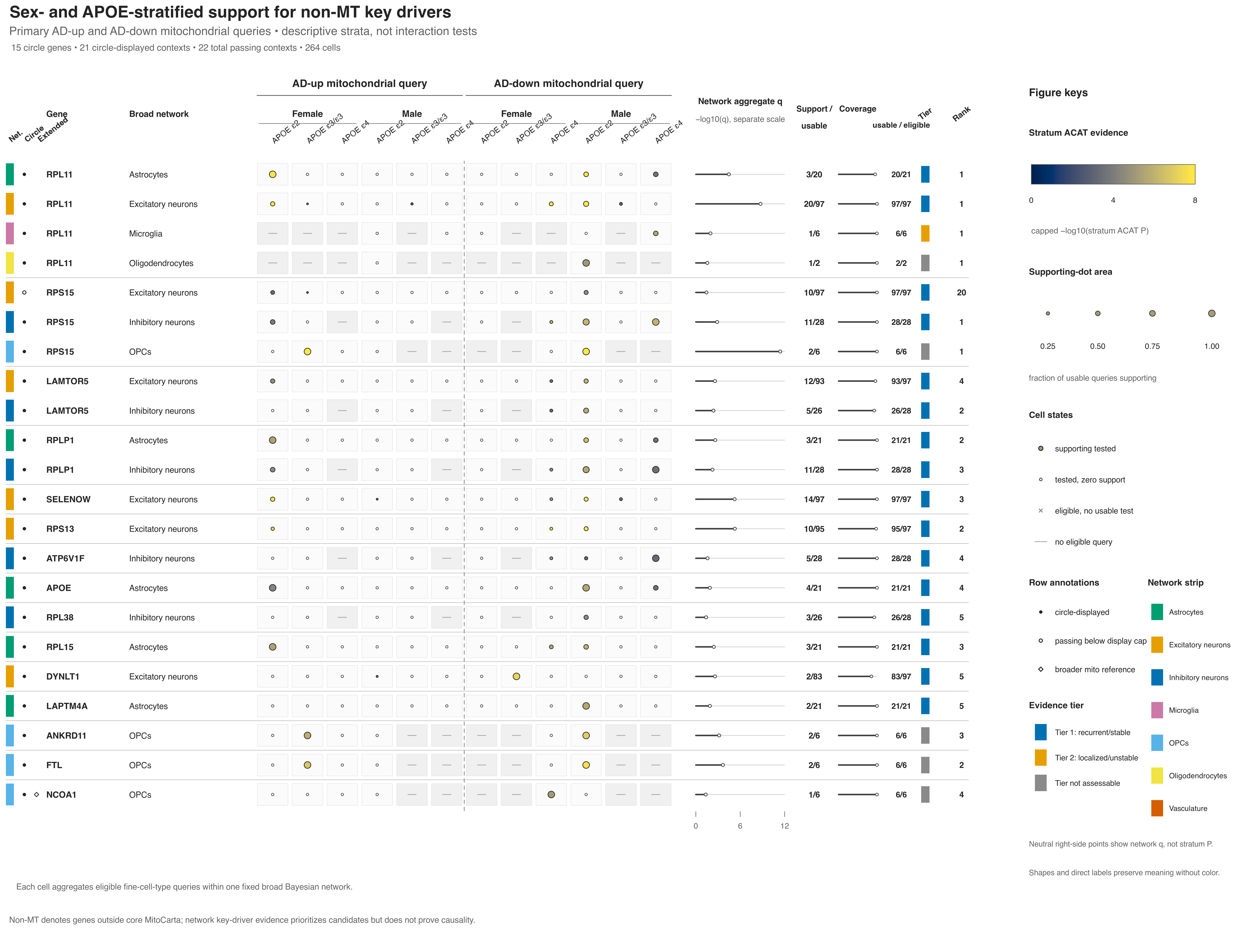
SEX/APOE EVIDENCE • NON-MT
11
Non-MT support concentrates in a smaller set of strata
The same visual grammar reveals broad recurrence for some drivers and sharply localized evidence for others.
Leading patterns
AD-down male ε2: 62 supporting runs in 19 contexts
AD-up female ε2: 28 supporting runs in 11 contexts
AD-down female ε4: 16 supporting runs in 10 contexts
AD-down male ε4: 10 supporting runs in 7 contexts
Candidate examples
RPL11 is recurrent across four networks; RPS15 is broad across neuronal/OPC contexts; APOE is localized to astrocytes. Large dots with small denominators should not be mistaken for broad replication.
Patterned evidence generates hypotheses; it does not establish specificity.
Source: phase18_sex_apoe_non_mt.png • descriptive totals match the validated figure guide

Slide 12
12
SECTION 02
02
Human genetic support
An independent check of whether public Alzheimer’s disease genetic signals map directly to the selected candidate genes.
IN THIS SECTION
Public summary data
Direct-mapping rules
Candidate-level results

Slide 13
HUMAN GENETIC SUPPORT • DATA
13
A compact public summary bundle tests all 25 candidates
This is an independent evidence line across every displayed gene × broad-network context—not a rerun of the network model.
What entered the analysis
Scale and portability
Selected key drivers
25 unique genes evaluated in all 47 displayed broad cell-type/network contexts.
25
47
01
unique candidate genes
gene × network contexts
Public human-genetics summaries
Official FunGen-xQTL Alzheimer’s disease snapshot: GWAS/fine-mapping, xQTL, TWAS and gene-level result tables.
6
~8.8 MiB
02
public source files
total downloaded bundle
Gene identity references
GENCODE v44 (GRCh38) coordinates plus the HGNC 2026-06-05 symbol table keep locus and gene mappings explicit.
03
LOCAL WORKSTATION READY
Small, tabular inputs; no cluster-scale compute required.
Summary-level only: no individual genotypes, phenotypes, or protected participant data.
Human genetics asks whether an independently measured AD-associated signal maps to the same candidate gene in a relevant context.
Sources: FunGen-xQTL public snapshot (2026-07-29) • GENCODE v44, GRCh38 • HGNC 2026-06-05

Slide 14
HUMAN GENETIC SUPPORT • METHOD
14
Direct gene mapping—not proximity—determines the grade
The workflow screens broadly, then prevents a nearby association from being mistaken for support of a specific candidate gene.
25 genes
19 nuclear genes
356 records
Direct mapping
47 candidate contexts
screen ±1 Mb per locus
candidate-locus variant records
target gene + evidence context
Set aside
Grade direct evidence
Mitochondrial route
352
regional proximity-only records
4 + 1
direct xQTL records + TWAS-list row
6
mtDNA genes • 20 contexts
They help locate candidate regions but do not name the candidate as the molecular target, so they are not counted as gene support.
Grade strong / moderate / weak from the source’s direct gene mapping, evidence type, and match to the broad cell context.
The available source lacks mtDNA-specific heteroplasmy, haplogroup, copy-number and NUMT controls; these contexts are not assessable.
Colocalization boundary: the public source provides prefiltered summaries, not H0–H4 posterior probabilities; missing statistics were not reconstructed or relabeled.
Decision rule: direct gene mapping can support a candidate; proximity alone cannot. Missing source coverage remains unresolved—not negative.
Method: registered candidate list • ±1 Mb nuclear-locus screen • direct-target review • context-aware evidence grading

Slide 15
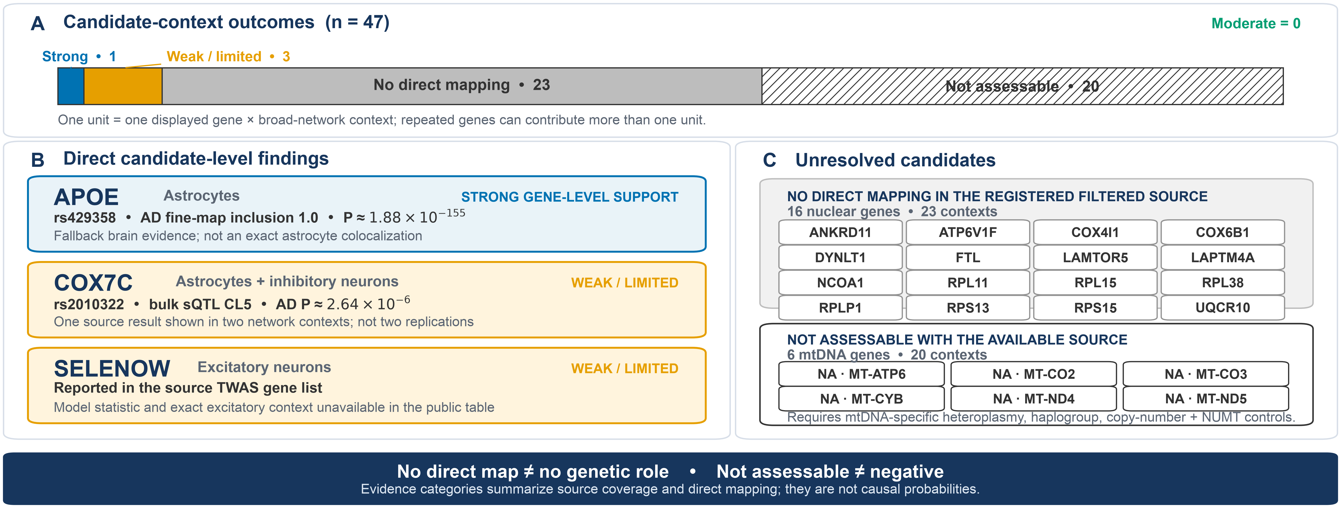
HUMAN GENETIC SUPPORT • RESULTS
15
APOE stands out; COX7C and SELENOW remain limited
Most candidates remain unresolved because direct mapping or appropriate source coverage was unavailable; the grades are not causal probabilities.
Source: validated human-genetic-support summary • FunGen-xQTL public snapshot • GENCODE v44 • HGNC 2026-06-05

Slide 16
16
SECTION 03
03
Key-driver network graphs & proteomics validation
Place prioritized key drivers in their cell-type network context, then test whether predicted modules are supported at the protein level.
IN THIS SECTION
Network graph overlays
Protein-level evidence
Proteomics validation

Slide 17
FIRST-BATCH VALIDATION PANEL
17
Why these seven candidates go first
Every listed gene × broad-network pairing is a separate validation unit; support in one network does not validate another.
GENE
BROAD NETWORK(S) TO VALIDATE
ROLE
WHY / PRIMARY TEST
APOE
Astrocytes
CALIBRATOR
Known-AD control; reproduce its frozen astrocyte mitochondrial target module.
COX7C
Astrocytes • Inhibitory neurons
GENETICS-INFORMED
Weak direct bulk-sQTL mapping; test network targets, complex-IV assembly, and protein stoichiometry.
SELENOW
Excitatory neurons
REINFORCED
Stable KDA plus tau/redox evidence; the source TWAS flag remains limited.
LAMTOR5
Excitatory neurons • Inhibitory neurons
CROSS-NETWORK
Two neuronal networks test lysosome–mTOR/mitochondria recurrence.
RPL11
Astrocytes • Excitatory neurons Microglia • Oligodendrocytes
BIAS TEST
Four selected networks; require expression-, degree-, and ribosomal-matched nulls.
FTL
OPCs
EXPLORATORY
Sparse OPC signal; localize the iron/ferroptosis mechanism before promotion.
ANKRD11
OPCs
NOVELTY TEST
Sparse OPC novelty test for chromatin-linked regulation.
Validate every listed gene × network unit separately; COX7C enters both astrocyte and inhibitory-neuron workstreams, but one bulk-sQTL result is not two replications.
Sources: Phase 18 call_key_driver_returns.tsv • cross-validation guide, Section 2 • Tier 1 human-genetic-support report

Slide 18
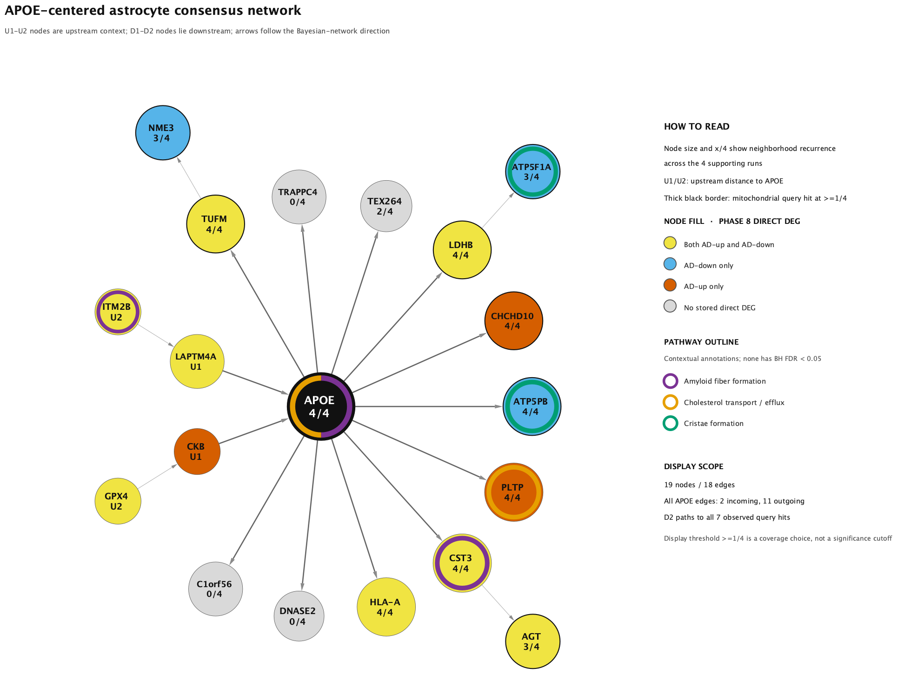
APOE • ASTROCYTES
24
APOE anchors a recurrent astrocyte mitochondrial neighborhood
APOE is an established AD gene; the Phase 18 contribution is its placement within a specific astrocyte mitochondrial network.
Evidence scale
4/14
1.27×10⁻²
supporting / tested astrocyte runs
aggregate ACAT q
Network readout
19 nodes, 18 directed edges, and seven mitochondrial query hits across four supporting runs.
APOE-linked paths reach ATP5F1A, ATP5PB, CHCHD10, LDHB, NME3, TUFM, and AGT.
Amyloid, cholesterol/efflux, and cristae outlines are contextual; none has BH FDR < 0.05.
Support spans three fine cell types and both mitochondrial directions; leave-one-fine-cell-type retention is 2/3.
Interpretation: credible network placement, but less stable than the strongest neuronal candidates and not proof of direct APOE regulation.
Source: phase18_apoe_astrocyte_consensus_network_pathways.png, caption, methods, and gene-by-gene analysis

Slide 19
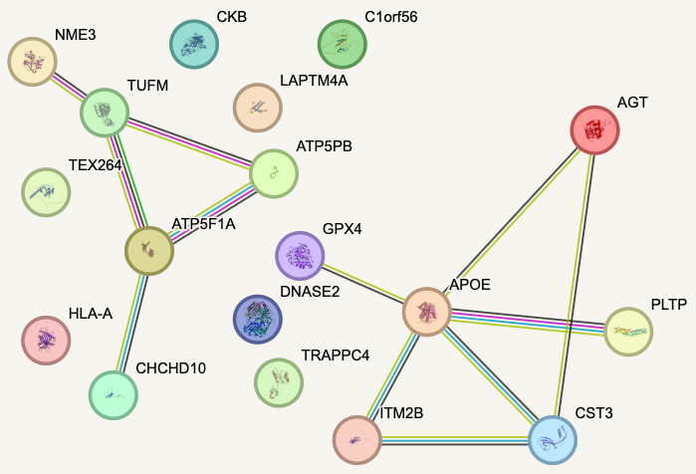
APOE • ASTROCYTES
25
STRING reveals two distinct APOE-neighborhood modules
Medium-confidence STRING associations are undirected and context-agnostic; they complement, but do not validate, Bayesian edge direction.
What the image supports
A mitochondrial protein cluster contains TUFM, ATP5F1A, ATP5PB, CHCHD10, and NME3.
APOE instead connects with a lipid/amyloid/stress neighborhood containing PLTP, CST3, AGT, ITM2B, and GPX4.
Their separation argues against reading this figure as a simple direct APOE→mitochondrial protein chain.
Mechanism and decisive test
Prior cell studies connect APOE4 to lysosomal cholesterol accumulation, impaired mitophagy, altered mitochondrial dynamics, and disrupted fatty-acid metabolism. Test whether that biology reproduces the exact Phase 18 target neighborhood in APOE2/3/4-isogenic astrocytes.
Measure respiration, substrate use, cholesterol distribution, mitophagy, lipid-droplet transfer, and the frozen target module; fit donor-level disease × sex × APOE interactions separately.
Observed female ε2, male ε2, and male ε4 support is descriptive—not evidence of an interaction.
Sources: stringdb_full_medium_conf.png • phase18_key_driver_gene_by_gene_initial_analysis.md • Lee 2023; Schmukler 2020; Qi 2021; Williams 2020

Slide 20
18
RPL11 DEEP DIVE
A ribosomal-stress candidate at the translation–mitochondria interface
Mechanistic model
Free RPL11 can inhibit MDM2 and activate p53; neuronal ribosomal stress can require RPL11 for p53-linked cell death.
RPL11 is the broadest non-MT network candidate, but the mechanistic claim depends on distinguishing a true stress transducer from a highly connected module marker.
RPL11 transmits stress into mitochondrial and survival programs.
4
29/84
25
15
Module-marker model
passing broad networks
significant / tested runs
conservative-support runs
supporting fine cell types
RPL11 may inherit strong KDA and STRING signals from high expression, ribosomal connectivity, or a general disease/quality response.
Human context
AD capillary proteomics reported increased RPL11/RPL15 protein, while earlier AD work supports ribosomal dysfunction. The capillary signal does not establish neuronal or astrocytic localization.
Target specificity and matched ribosomal nulls decide between the models.
Biological discussion: phase18_key_driver_gene_by_gene_initial_analysis.md • Zhang 2003; Slomnicki 2018; Suzuki 2022; Ding 2005

Slide 21
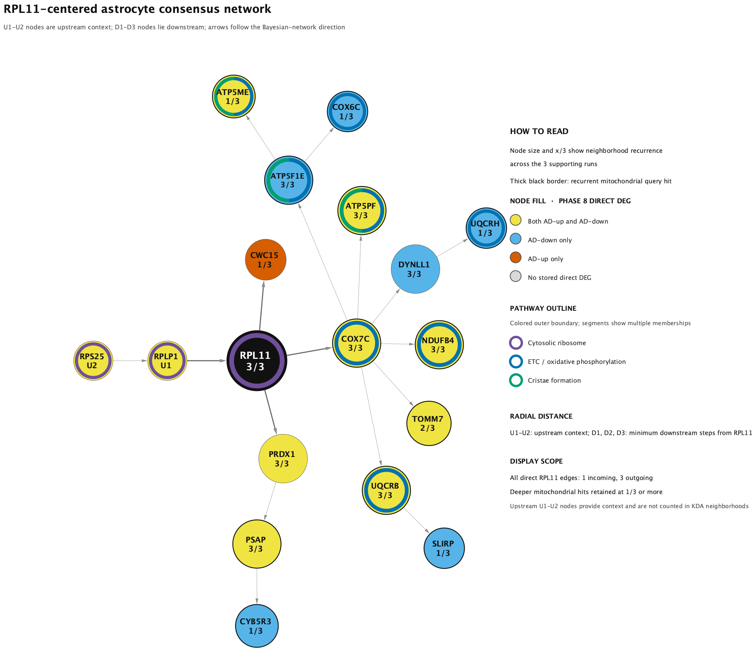
RPL11 • ASTROCYTES
19
A focused respiratory branch emerges from three supporting runs
Directed Bayesian-network edges are model-derived regulatory hypotheses; pathway outlines summarize the displayed genes.
Evidence scale
3/20
3.44×10⁻⁵
supporting / usable astrocyte runs
aggregate ACAT q
Network readout
18 nodes, 17 directed edges, and 12 mitochondrial query hits.
Upstream chain: RPS25 → RPLP1 → RPL11. Direct outputs: COX7C, CWC15, and PRDX1.
ETC/OXPHOS: 8 genes, BH FDR 1.98×10⁻⁸. Cristae formation: 3 genes, FDR 0.00475.
The ribosome outline is contextual (FDR 0.0805), not significant at 0.05.
Interpretation: a reproducible but relatively small astrocyte signal connects RPL11 to a coherent respiratory/cristae branch.
Source: phase18_rpl11_astrocyte_consensus_network_pathways.png, caption, methods, and ORA table

Slide 22
RPL11 • ASTROCYTES
20
STRING supports target-module coherence more clearly than direct regulation
Medium-confidence STRING functional associations are undirected and are not astrocyte- or AD-specific.
What the image supports
The respiratory targets form a dense protein-association core spanning complex I, III, IV, and V proteins.
RPL11 is sparsely connected relative to the target-to-target core; PSAP and CYB5R3 remain visually isolated in this view.
The visual density therefore supports a coherent mitochondrial module, but it cannot by itself show that RPL11 regulates that module.
Claim boundary
A direct RPL11 claim requires the input-only physical network, edge-level experimental/curated evidence, a ≥0.700 threshold, and matched ribosomal/topology controls. Until then, the medium-confidence figure is suggestive module-level cross-validation.
Allowed conclusion: protein-level coherence of the target module; direct RPL11 support remains provisional.
Source: astrocyte/stringdb_full_medium_conf.png • interpretation follows rpl11_astrocyte_string_analysis_guide.md

Slide 23
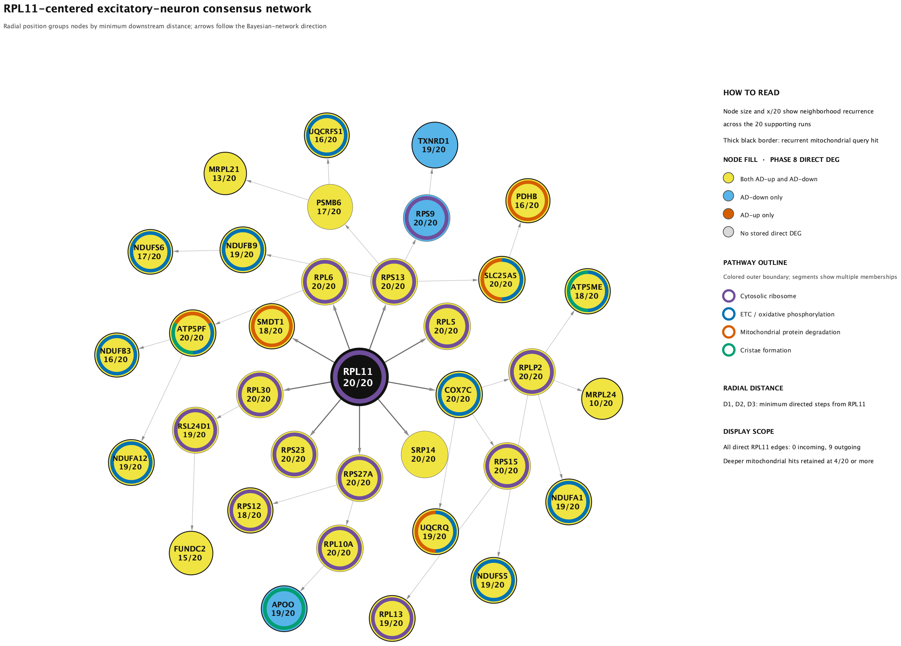
RPL11 • EXCITATORY NEURONS
21
A broader translation–mitochondria interface recurs across 20 runs
The excitatory context has stronger aggregate evidence and complete leave-one-fine-cell-type candidate retention.
Evidence scale
20/97
1.84×10⁻⁹
supporting / usable excitatory runs
aggregate ACAT q
Network readout
35 nodes, 34 directed edges, 21 mitochondrial query hits, and 9 direct RPL11 outputs.
Direct outputs include ribosomal proteins plus COX7C and SMDT1, creating a model-derived bridge to mitochondrial functions.
Cytosolic ribosome: 14 genes, FDR 1.35×10⁻¹⁶; ETC/OXPHOS: 12 genes, FDR 3.20×10⁻¹³.
Mitochondrial protein degradation (FDR 0.00180) and cristae formation (FDR 0.00762) add proteostasis/structure hypotheses.
Interpretation: the excitatory signal is broader and more recurrent, but its ribosomal density makes specificity controls essential.
Source: phase18_rpl11_excitatory_consensus_network_pathways.png, node/edge tables, and ORA table

Slide 24
RPL11 • EXCITATORY NEURONS
22
STRING resolves ribosomal and respiratory protein neighborhoods
The displayed functional network is useful for architecture; it does not preserve Bayesian edge direction.
Architecture
RPL11 sits with cytosolic/mitochondrial ribosomal proteins, while the respiratory proteins form a dense OXPHOS core.
The view is consistent with a ribosome–mitochondria interface rather than one simple RPL11→target protein chain.
Respiratory-protein density is expected and can dominate whole-network PPI enrichment.
Exploratory elements
MRPS18C, COX17, COX20, and PINK1 appear as STRING-side connectors rather than prespecified Bayesian-consensus nodes. They are mechanism hypotheses—not validation endpoints.
Test RPL11-to-target edges separately from target-to-target connectivity.
Source: excitatory/stringdb_full_medium_conf.png • medium-confidence functional STRING view

Slide 25
RPL11 SYNTHESIS
23
The excitatory signal is broader; the astrocyte signal is more focused
Both contexts support a translation/stress-to-mitochondria hypothesis, while leaving target specificity unresolved.
ASTROCYTES
EXCITATORY NEURONS
Focused respiratory branch
Broad translation–mitochondria interface
3/20 supporting runs; aggregate q 3.44×10⁻⁵.
20/97 supporting runs; aggregate q 1.84×10⁻⁹.
18-node directed consensus with ETC/OXPHOS and cristae enrichment.
35-node consensus combines ribosome, OXPHOS, cristae, and mitochondrial proteostasis.
STRING shows a dense target core but comparatively sparse RPL11 connectivity.
STRING separates a ribosomal neighborhood and dense respiratory core with exploratory connectors.
Best current framing: focused, plausible, and still in need of protein-edge/null validation.
Best current framing: stronger recurrence, but higher risk of generic ribosomal-module effects.
DECISIVE VALIDATION
Match for expression, degree, neighborhood size, and ribosomal class → use partial CRISPRi/CRISPRa in APOE-isogenic astrocytes and excitatory neurons → measure predicted MT targets, p53, nascent translation, respiration, and viability → add p53 inhibition/rescue and spatial/vascular proteomics.
Interpretation and validation priorities synthesized from phase18_key_driver_gene_by_gene_initial_analysis.md

Slide 26
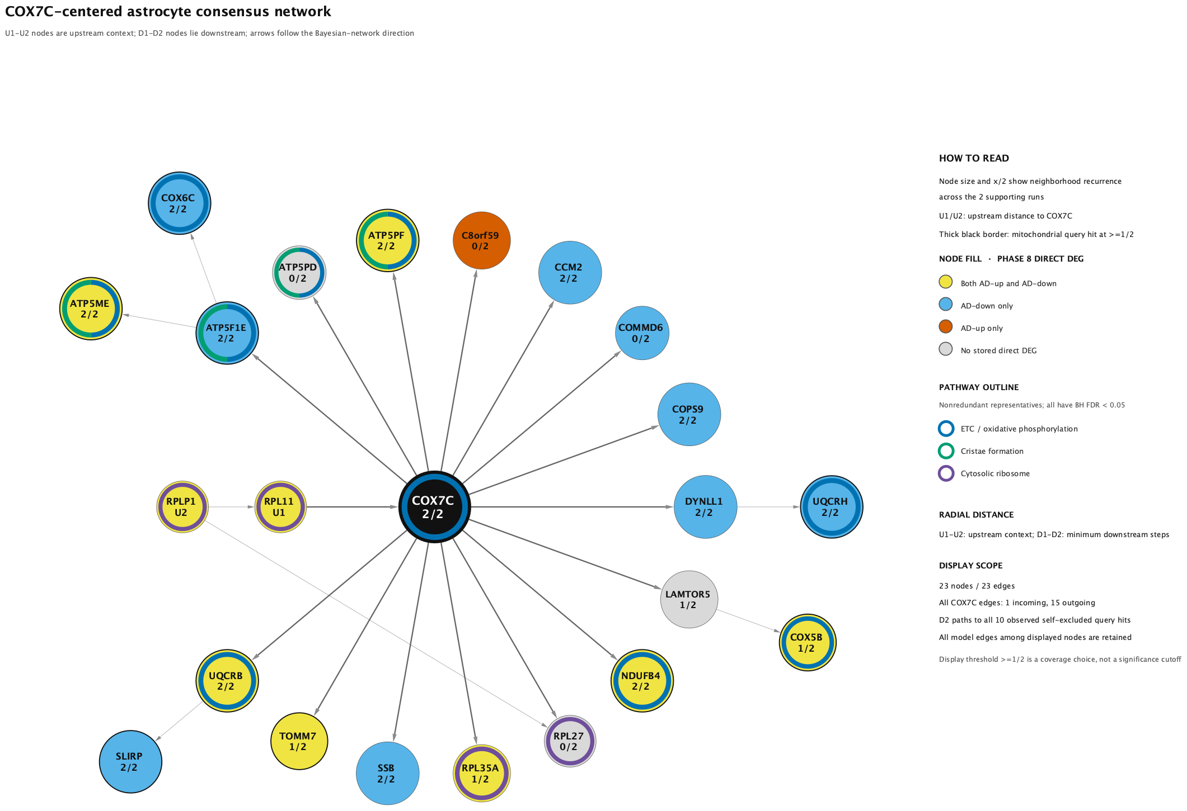
COX7C • ASTROCYTES
26
A compact astrocyte signal maps to a coherent respiratory module
COX7C was self-excluded from both mitochondrial queries; the retained hits therefore reflect other genes in its modeled neighborhood.
Evidence scale
2
5.14×10⁻⁴
conservative-support astrocyte runs
aggregate ACAT q
Network readout
23 nodes and 23 directed edges retain ten self-excluded mitochondrial query hits.
Upstream chain: RPLP1 → RPL11 → COX7C; COX7C has 15 direct modeled outputs.
ETC/OXPHOS: 10 genes, FDR 3.27×10⁻¹¹; cristae: 4 genes, FDR 1.45×10⁻⁴; cytosolic ribosome: 4 genes, FDR 0.00722.
The 1/2 display threshold preserves ten hits; requiring 2/2 would retain only four.
Interpretation: strong respiratory-module coherence, but the two-run astrocyte result needs independent replication.
Source: phase18_cox7c_astrocyte_consensus_network_pathways.png, caption, methods, ORA table, and gene-by-gene analysis

Slide 27
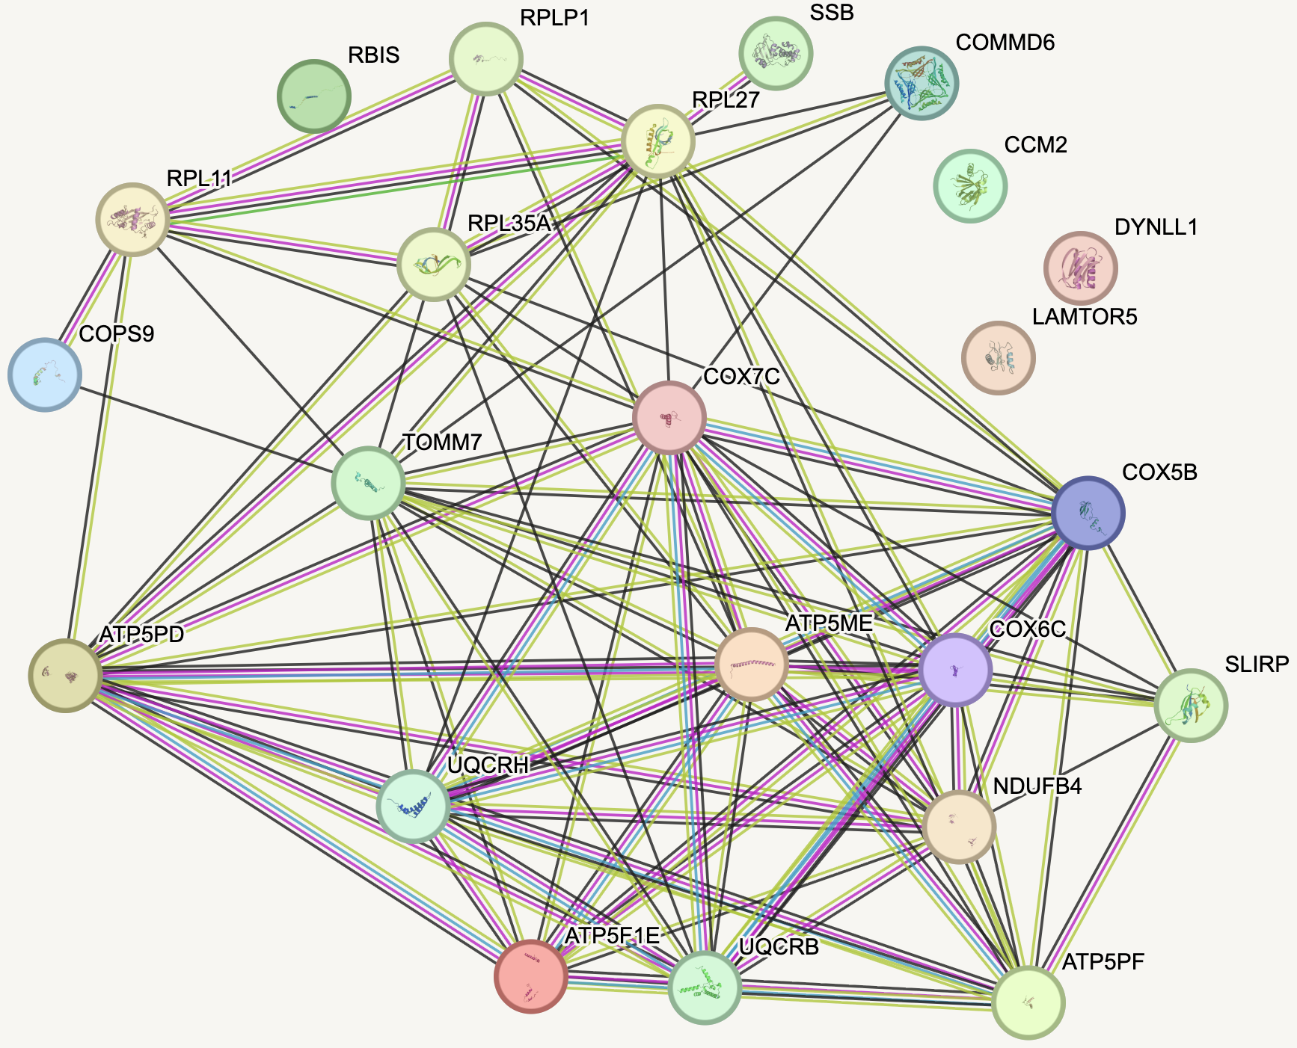
COX7C • ASTROCYTES
27
STRING places COX7C in a dense respiratory core
Medium-confidence STRING associations are undirected and not astrocyte- or AD-specific; dense complex membership is expected.
What the image supports
COX7C sits in a dense association core spanning complex I, III, IV, and V proteins plus TOMM7 and SLIRP.
A highly connected ribosomal branch echoes the modeled RPLP1 → RPL11 → COX7C upstream chain.
Several Bayesian-neighborhood proteins remain weakly connected or isolated, so STRING does not validate every modeled edge.
Driver or respiratory sentinel?
COX7C is nuclear encoded and is mostly AD-down in earlier DEG results, contrasting with many AD-up mtDNA-encoded subunits. That pattern supports a mitonuclear-stoichiometry hypothesis, but STRING density alone cannot make COX7C an upstream regulator.
Compare mild COX7C and COX4I1 perturbation: exact target module, complex-IV assembly/activity, protein stoichiometry, respiration, and mitochondrial mass. Replicate the astrocyte result independently.
The weak direct bulk-sQTL supports prioritization; one source is not replication of both network contexts.
Sources: stringdb_full_medium_conf.png • phase18_key_driver_gene_by_gene_initial_analysis.md • human-genetic-support review

Slide 28
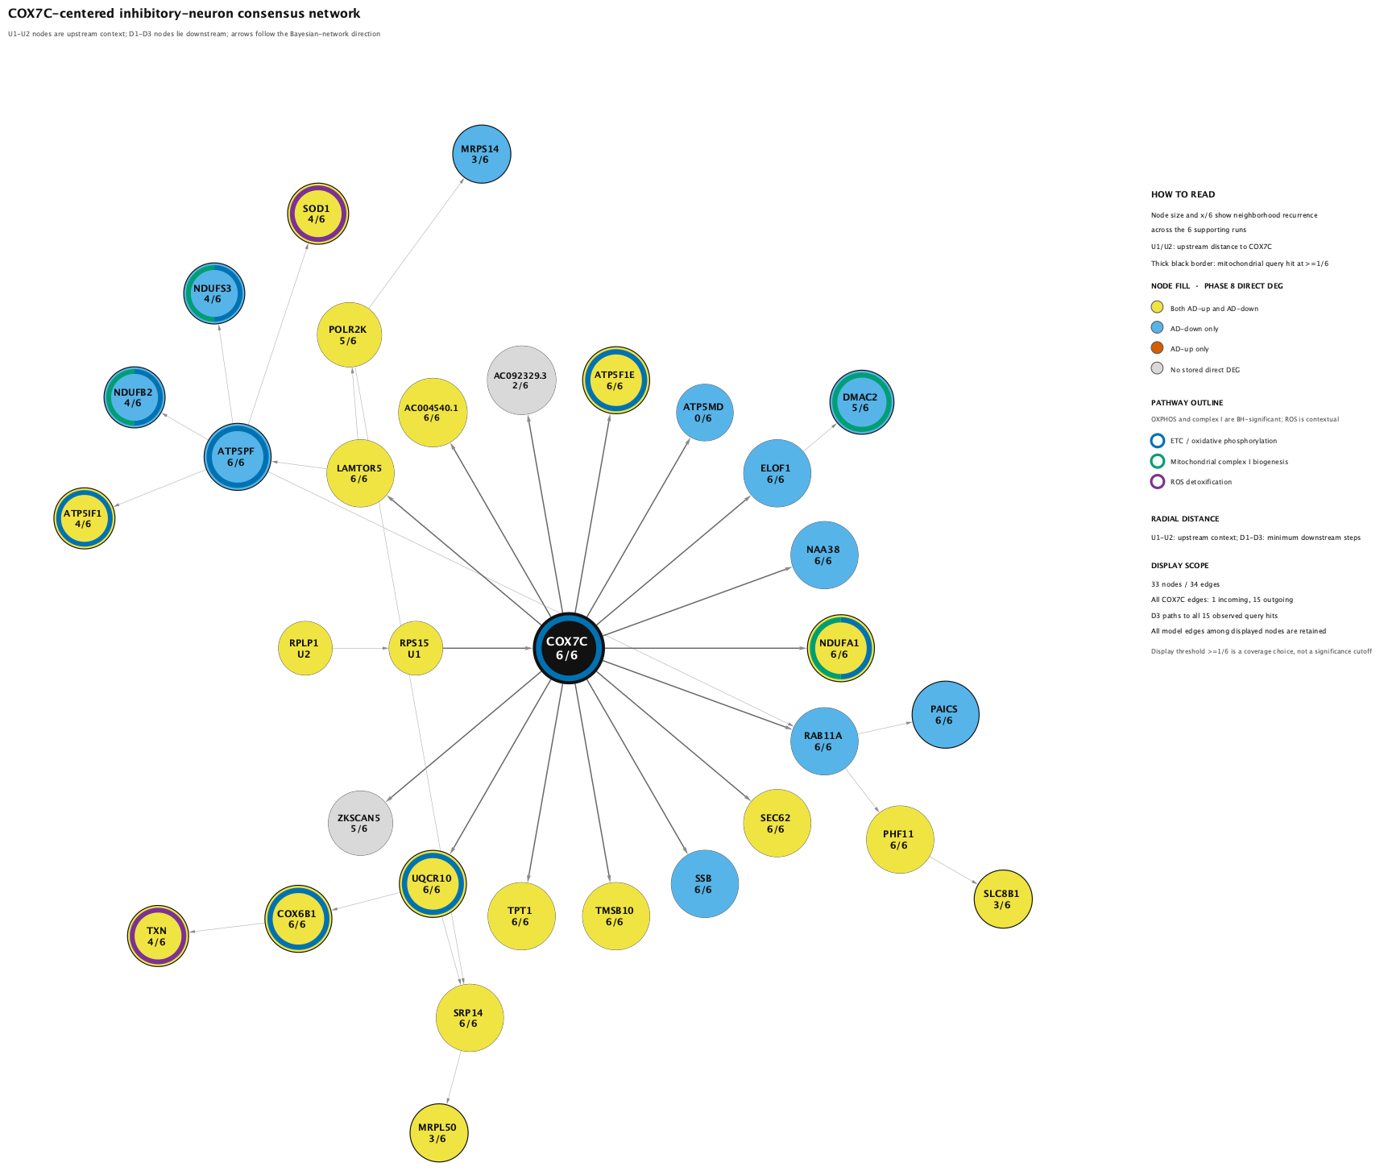
COX7C • INHIBITORY NEURONS
28
The inhibitory-neuron signal is stronger and fully stable
Six conservative-support runs yield a broader consensus than astrocytes, with complete leave-one-fine-cell-type candidate retention.
Evidence scale
6
6.24×10⁻⁶
conservative-support inhibitory runs
aggregate ACAT q
Network readout
33 nodes and 34 directed edges retain 15 mitochondrial query hits; candidate-retention fraction is 1.00.
Upstream chain: RPLP1 → RPS15 → COX7C—distinct from the astrocyte RPL11 route.
ETC/OXPHOS: 9 genes, FDR 6.11×10⁻⁸; complex-I biogenesis: 4 genes, FDR 0.0149.
ROS detoxification is contextual (FDR 0.192); 1/6 preserves all hits, while 2/6 retains eight.
Interpretation: a stable respiratory core with exploratory single-run branches; five AD-down and one AD-up contexts are descriptive, not interactions.
Source: phase18_cox7c_inhibitory_consensus_network_pathways.png, caption, methods, ORA table, and gene-by-gene analysis

Slide 29
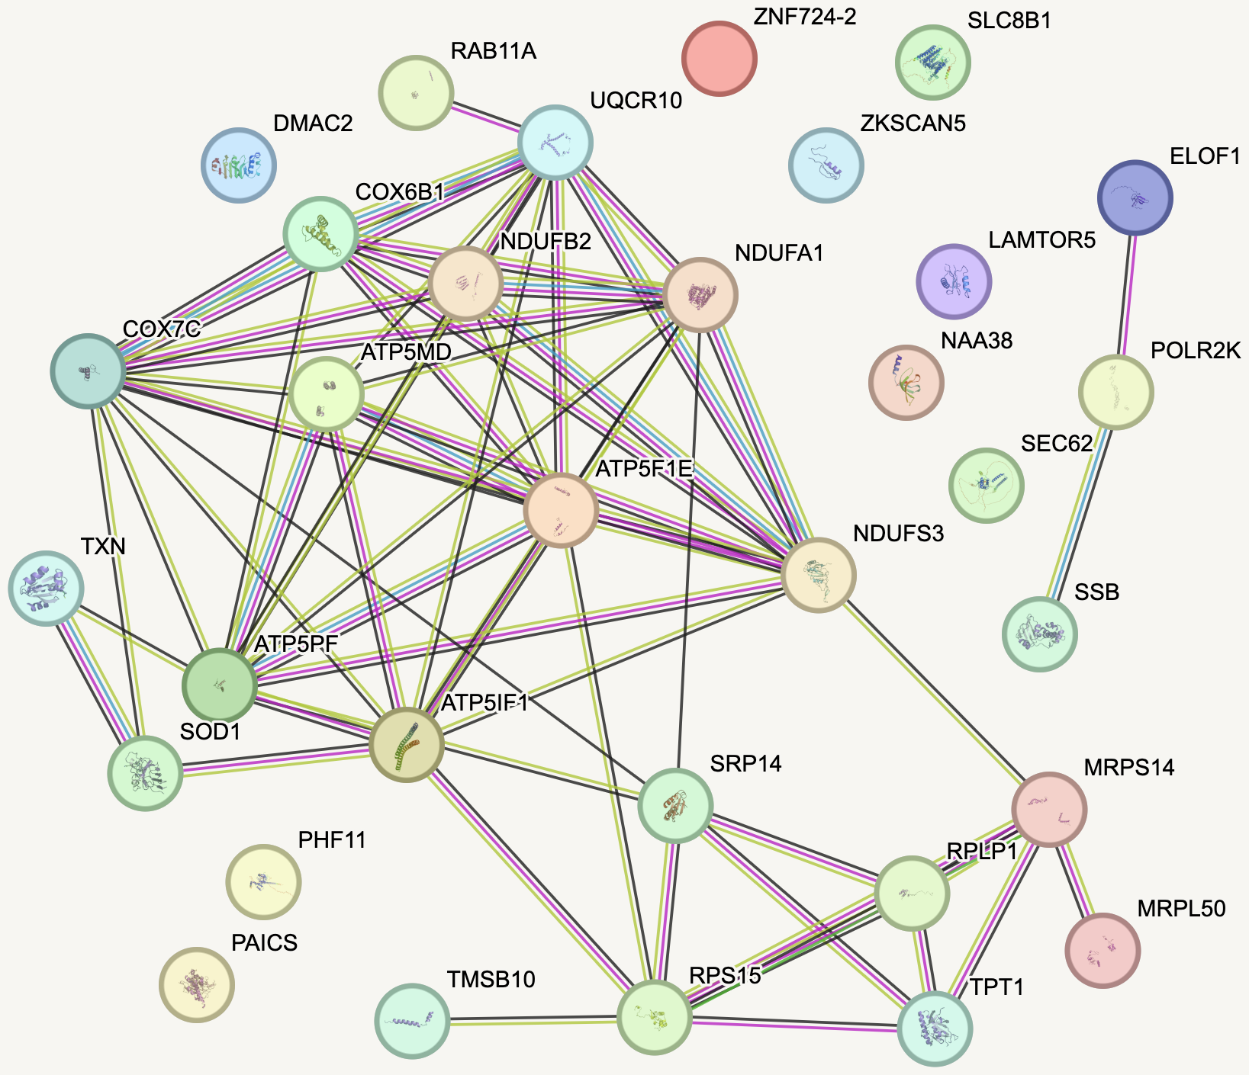
COX7C • INHIBITORY NEURONS
29
STRING reinforces the respiratory core—not edge direction
Medium-confidence STRING associations are undirected and not inhibitory-neuron- or AD-specific.
What the image supports
COX7C joins a dense OXPHOS core containing complex I, III, IV, and V proteins.
SOD1 and TXN connect to the core, but neither STRING connectivity nor the contextual ROS outline proves pathway activation.
A translation/mitochondrial-ribosome branch includes RPS15, RPLP1, MRPS14, MRPL50, SRP14, and TPT1.
Weakly connected or isolated proteins show that STRING does not validate every Bayesian-neighborhood edge.
Cross-network validation
The stable inhibitory result and the weaker astrocyte result independently nominate COX7C within two different network models. This strengthens prioritization, but a shared bulk-sQTL and expected respiratory-complex connectivity do not establish causality.
Use mild perturbation in inhibitory subtypes; compare COX7C with COX4I1 and assay the exact target module, complex-IV assembly/activity, mitonuclear stoichiometry, respiration, ROS, and survival.
A specific module response at a dose that avoids generic respiratory collapse is the decisive result.
Sources: stringdb_full_medium_conf.png • phase18_key_driver_gene_by_gene_initial_analysis.md • cross-validation and human-genetic-support reviews

Slide 30
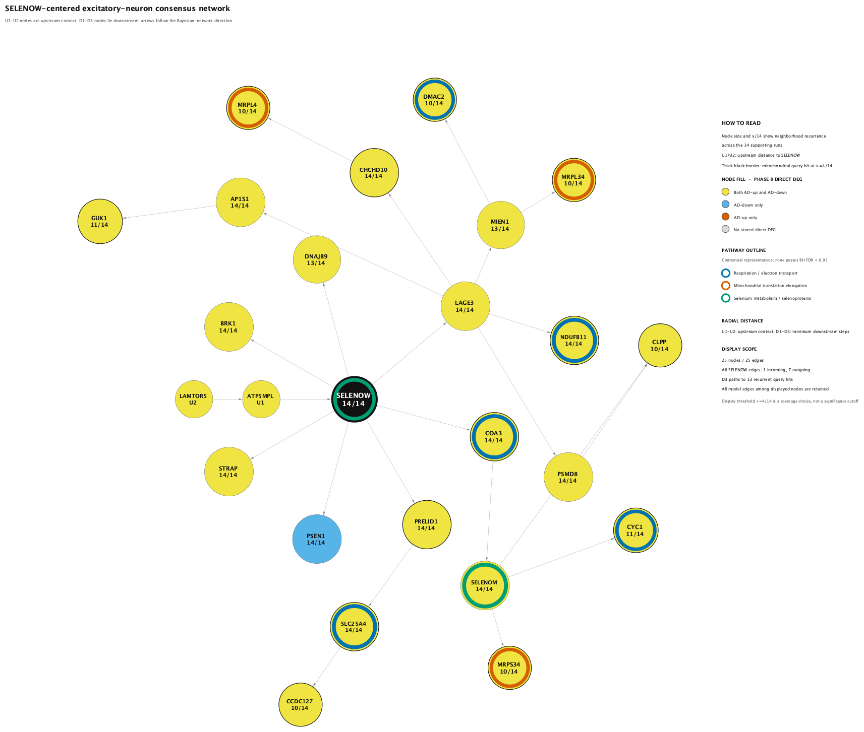
SELENOW • EXCITATORY NEURONS
30
SELENOW anchors a stable excitatory mitochondrial program
Fourteen conservative-support runs across nine fine cell types yield complete leave-one-fine-cell-type candidate retention.
Evidence scale
14
5.75×10⁻⁶
conservative-support excitatory runs
aggregate ACAT q
Network readout
25 nodes and 25 directed edges retain 13 of 14 observed mitochondrial query hits at the 4/14 display threshold.
Upstream chain: LAMTOR5 → ATP5MPL → SELENOW; seven direct outputs include COA3, PRELID1, PSEN1, and LAGE3.
CHCHD10 and PRELID1 recur in all 14 query overlaps; NDUFB11 recurs in 13 and COA3/SLC25A4 in 11.
Respiration, mitochondrial translation, and selenium outlines are contextual; none has BH FDR < 0.05.
Interpretation: strong, stable topology plus external AD biology; pathway labels organize the graph but do not establish enrichment or activity.
Source: phase18_selenow_excitatory_consensus_network_pathways.png, caption, methods, ORA table, and gene-by-gene analysis

Slide 31
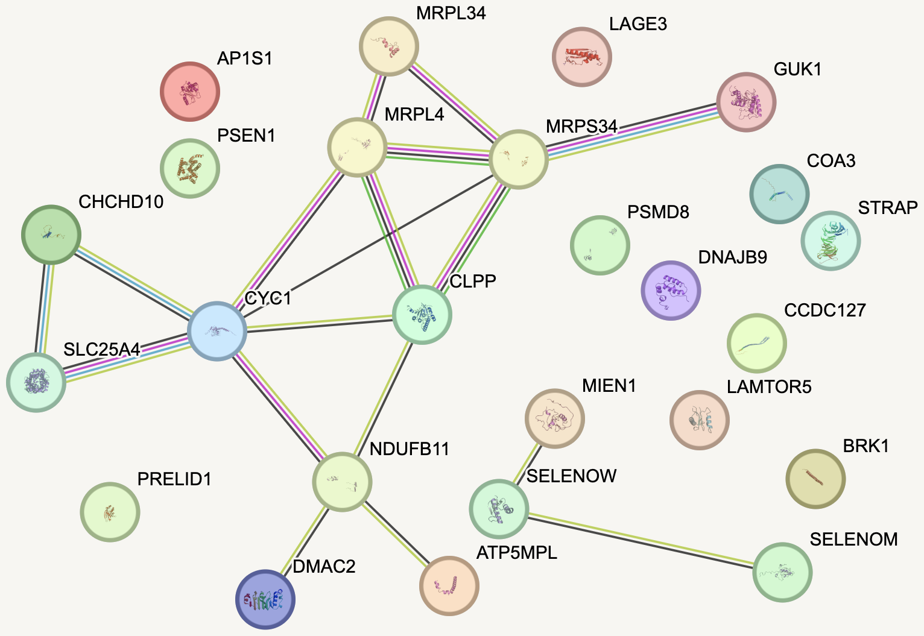
SELENOW • EXCITATORY NEURONS
31
STRING separates SELENOW from the mitochondrial protein core
Medium-confidence STRING associations are undirected and not excitatory-neuron- or AD-specific.
What the image supports
A coherent mitochondrial component spans respiratory proteins, mitochondrial ribosomal proteins, CLPP, and SLC25A4.
SELENOW sits in a small association component with SELENOM and MIEN1 rather than inside the respiratory core.
Several modeled outputs are weakly connected or isolated, so STRING supports target-module coherence more than a direct SELENOW→module chain.
Externally reinforced mechanism
Direct AD-model evidence indicates that SELENOW binds tau, promotes ubiquitin–proteasome clearance, and improves tau pathology and memory when overexpressed. Independent work supports redox and respiration functions, providing a second route to the predicted mitochondrial phenotype.
In APOE-isogenic excitatory neurons under Aβ or tau stress, use CRISPRi/CRISPRa and rescue with wild-type versus redox-site-mutant SELENOW; measure tau clearance, proteasome activity, ROS/glutathione, respiration, viability, and the frozen target module.
The rescue separates redox-dependent action from scaffolding/proteostasis effects.
Sources: stringdb_full_medium_conf.png • phase18_key_driver_gene_by_gene_initial_analysis.md • Ren 2024; Misra 2023; Jeong 2002

Slide 32
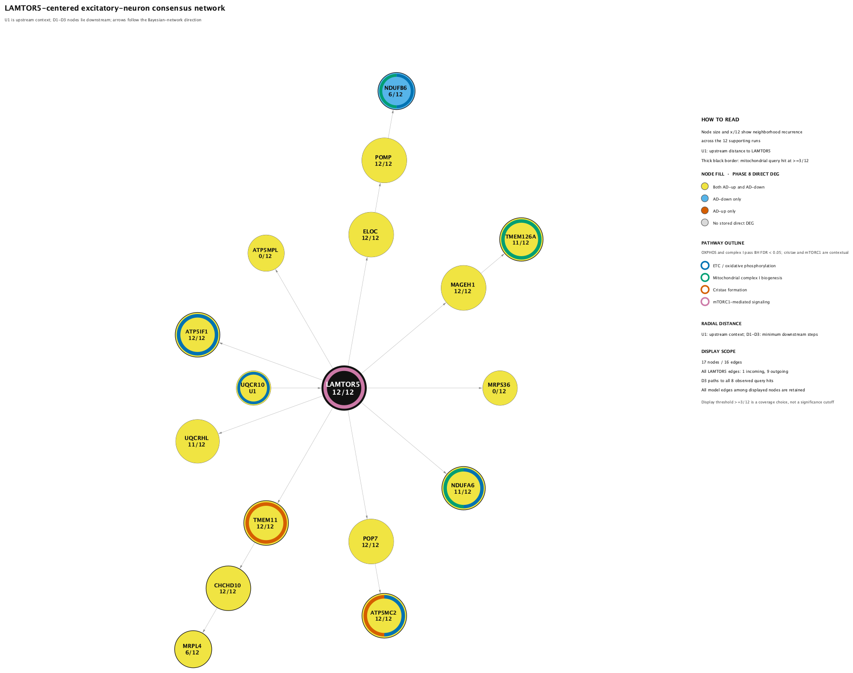
LAMTOR5 • EXCITATORY NEURONS
32
LAMTOR5 anchors a stable lysosome-to-respiration hypothesis
Twelve excitatory runs; LAMTOR5 also reproduces in inhibitory neurons, with complete omission retention in both networks.
Evidence scale
12
2.59×10⁻³
conservative-support excitatory runs
aggregate ACAT q
Network readout
17 nodes and 16 directed edges retain all eight observed mitochondrial query hits at the 3/12 display threshold.
UQCR10 → LAMTOR5 supplies upstream context; nine direct outputs include ATP5IF1, NDUFA6, TMEM11, and UQCRHL.
ETC/OXPHOS: 5 genes, FDR 8.23×10⁻⁴; complex-I biogenesis: 3 genes, FDR 0.0449.
Cristae and mTORC1 outlines are contextual, not significant; 4/12 would remove only TMEM126A.
Interpretation: recurrence and respiratory enrichment support a focused regulatory hypothesis; neither the arrows nor pathway labels prove causality or pathway activity.
Source: phase18_lamtor5_excitatory_consensus_network_pathways.png, caption, methods, ORA table, and gene-by-gene analysis

Slide 33
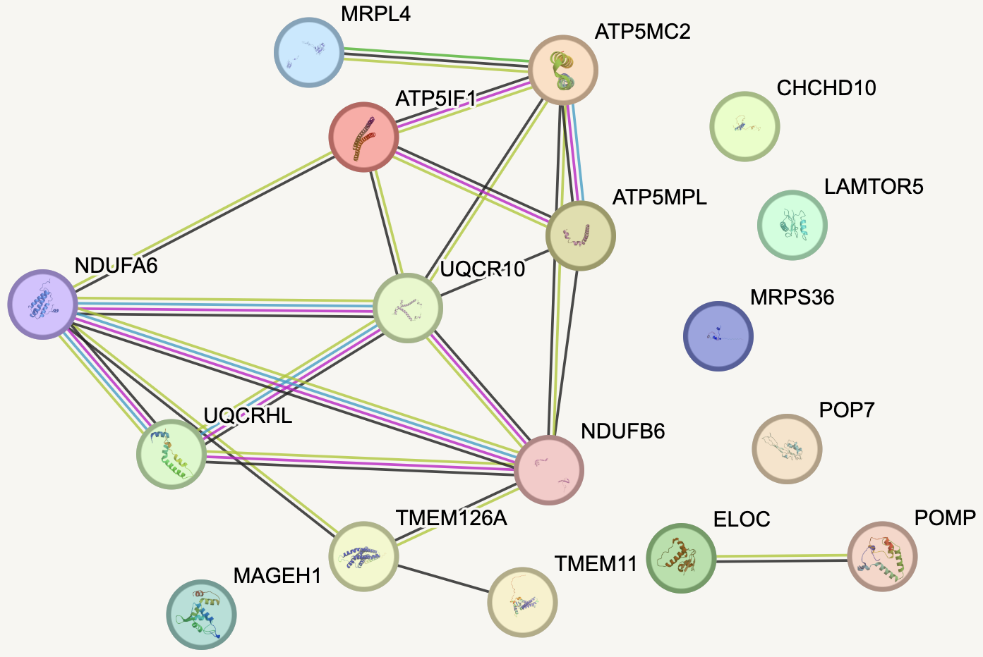
LAMTOR5 • EXCITATORY NEURONS
33
STRING supports the respiratory module—not a LAMTOR5 bridge
Medium-confidence STRING associations are undirected and not excitatory-neuron- or AD-specific.
What the image supports
A dense target component connects complex I/III/V proteins, including NDUFA6, NDUFB6, UQCR10/UQCRHL, and ATP5 subunits.
LAMTOR5 has no medium-confidence edge to this module, so STRING does not corroborate the modeled LAMTOR5→target chain.
CHCHD10, MRPS36, POP7, and MAGEH1 are also isolated; ELOC–POMP forms a separate pair, showing uneven protein-level support.
Mechanism worth testing
External biology supplies a plausible bridge: LAMTOR5 is a Ragulator subunit that recruits mTORC1 to lysosomes; mTORC1 regulates mitochondrial output, Aβ can disrupt lysosome-to-mitochondria signaling, and defective LAMTOR5 can impair V-ATPase assembly and acidification. Direct LAMTOR5 perturbation in AD remains untested.
In APOE-isogenic excitatory neurons, combine CRISPRi/CRISPRa with amino-acid withdrawal/re-feeding; measure lysosomal pH, mTORC1 localization, p-S6K/4EBP1, mitophagy, OCR, and the frozen target module, then perform LAMTOR5 rescue.
Female ε2 AD-up versus female ε4/male ε2 AD-down support suggests context dependence—not a universal direction.
Sources: stringdb_full_medium_conf.png • phase18_key_driver_gene_by_gene_initial_analysis.md • Bar-Peled 2012; Morita 2013; Norambuena 2018; Zhang 2024

Slide 34
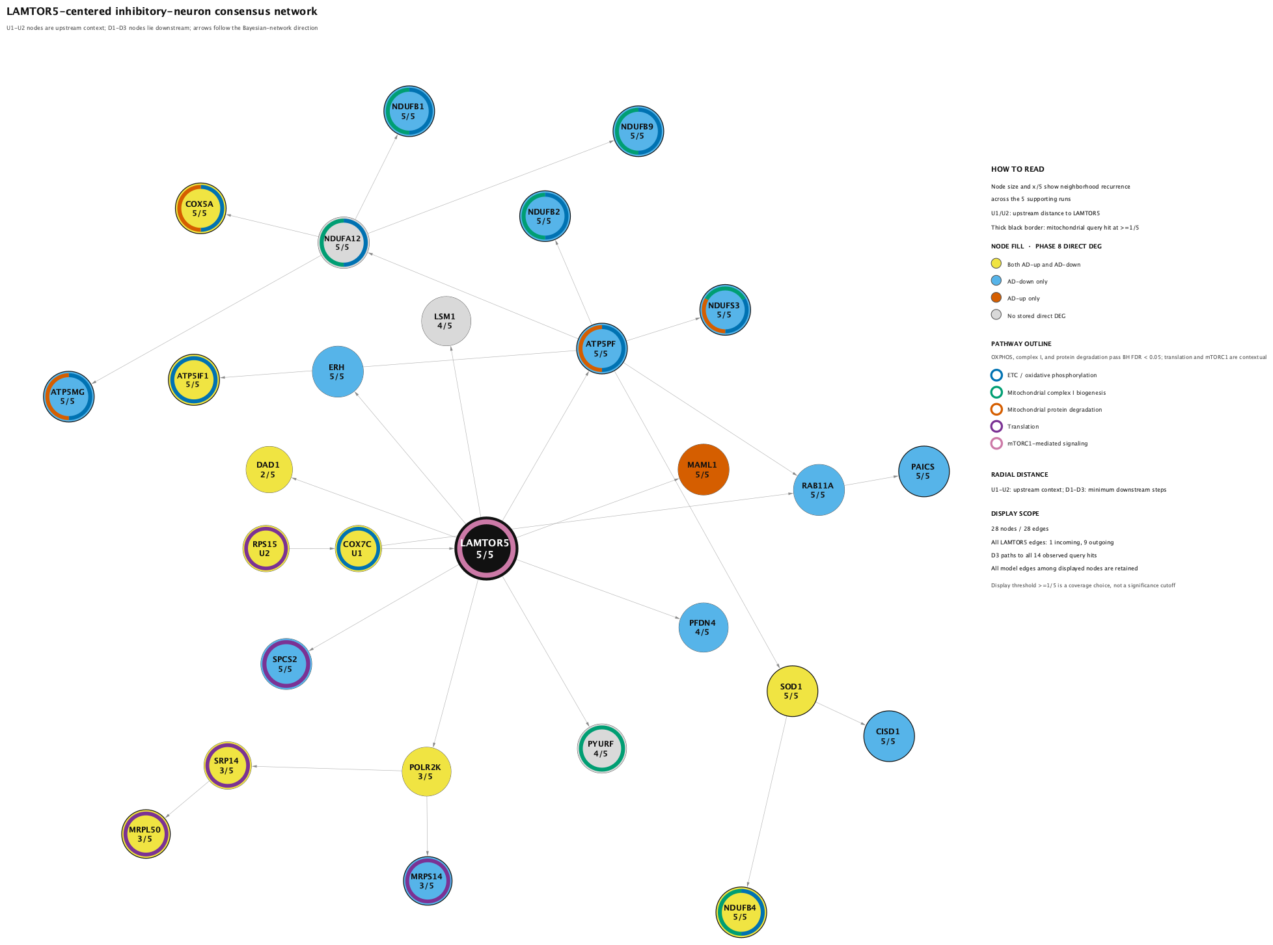
LAMTOR5 • INHIBITORY NEURONS
34
LAMTOR5 expands into a respiratory/proteostasis program
Five inhibitory runs show complete omission retention; every supporting context uses an AD-down mitochondrial query.
Evidence scale
5
4.14×10⁻³
conservative-support inhibitory runs
aggregate ACAT q
Network readout
28 nodes and 28 directed edges retain all 14 observed mitochondrial query hits at 1/5; 2/5 retains nine, leaving five single-run branches exploratory.
Upstream chain: RPS15 → COX7C → LAMTOR5; nine direct outputs include ATP5PF, which fans into respiratory and redox targets.
ETC/OXPHOS: 11 genes, FDR 9.95×10⁻¹²; complex-I biogenesis: 7 genes, FDR 4.69×10⁻⁷; protein degradation: 4 genes, FDR 0.0253.
Interpretation: stronger pathway coherence but shallower recurrence than the excitatory network; translation and mTORC1 outlines remain contextual.
Source: phase18_lamtor5_inhibitory_consensus_network_pathways.png, caption, methods, ORA table, and gene-by-gene analysis

Slide 35
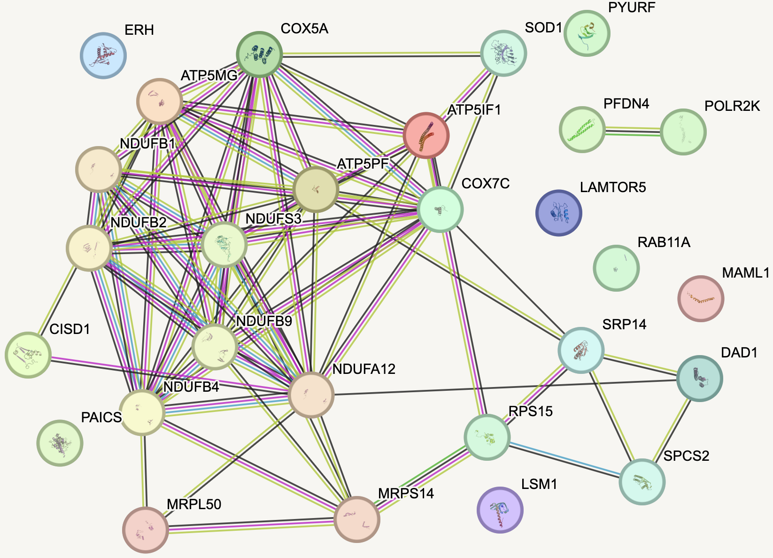
LAMTOR5 • INHIBITORY NEURONS
35
STRING supports the targets—not a LAMTOR5 connection
Medium-confidence STRING associations are undirected and not inhibitory-neuron- or AD-specific.
What the image supports
A dense respiratory component spans complex I, IV, and V proteins plus SOD1 and CISD1, strongly supporting target-module coherence.
LAMTOR5 remains isolated at medium confidence, so STRING does not provide the missing LAMTOR5→respiratory protein bridge.
A separate SRP14/RPS15/SPCS2/DAD1 branch and several isolated proteins show that support is modular, not uniform across modeled edges.
Cross-neuronal test
Across excitatory and inhibitory neurons, LAMTOR5 totals 17 conservative-support runs across 13 fine cell types with complete omission retention. Ragulator–mTORC1 and V-ATPase/acidification biology make the route plausible, but no direct gene-specific AD perturbation study was identified.
Compare APOE-isogenic inhibitory and excitatory neurons after LAMTOR5 CRISPRi/CRISPRa plus amino-acid withdrawal/re-feeding: lysosomal pH, mTORC1 localization, p-S6K/4EBP1, mitophagy, OCR, and each frozen target module; require sgRNA-resistant rescue.
All five inhibitory runs are AD-down—four male ε2 and one female ε4—but this is descriptive, not an interaction test.
Sources: stringdb_full_medium_conf.png • phase18_key_driver_gene_by_gene_initial_analysis.md • Bar-Peled 2012; Morita 2013; Norambuena 2018; Zhang 2024

